Slide 1
Digital Portfolio
STUDENT NAME: M.N.Rudrashan
REGISTER NO AND NMID: 222407877 AND autunm1455ds242717
DEPARTMENT:.SC(CS WITH DS)
COLLEGE: TAGORE ARTS & SCIENCE

Slide 2
PROJECT TITLE
RX100 Bike advertisement (digital portfolio)
Tagline: “The Legend Returns-Power. style. Freedom.”

Slide 3


AGENDA
Problem Statement
Project Overview
End Users
Tools and Technologies
Portfolio design and Layout
Features and Functionality
Results and Screenshots
Conclusion
Github Link
3/21/2024 Annual Review

Slide 4
PROBLEM STATEMENT
RX100 is an iconic bike loved for decades,but its promotion was limited to posters and old-school ads.
Today’s youth connect more with digital-first content than traditional Marketing.
There is no interactive , modern advertisement for RX100 that can match its legacy with today’s style.
hence, a digital advertisement portfolio is needed to bring RX100 closer to the new generation.

Slide 5

PROJECT OVERVIEW
RX100 Advertisement portfolio is a web-based showcase Designed like a modern ad campaign.
Highlights speed, mileage, comfort, and style in a sleek Digital format.
Includes interactive visuals , gallery , and enquiry options to Engage customers.
Acts as both a promotion tool for dealers and a brand Identity revival for Yamaha RX100.

Slide 6

WHO ARE THE END USERS?
Young Riders(18-30 yrs): Attracted by performance , speed,And style.
Classic Bike Enthusiasts: Loyal RX100 fans reliving nostalgia.
Dealers & Showrooms: Use protfolio to attract customers and Boost sales.
General Public: New customers who may get interested after seeing digital ads.

Slide 7

TOOLS AND TECHNIQUES
Frontend: HTML ,CSS , JavaScript - interactive web design.
Design Tools: Canva/Photoshop-High-quality RX100 posters ,banners.
Database: MySQL/SQLite-storing enquiries and leads.
Backend(optional): Flask/Nodes.js-For managing customers queries.
Hosting: GitHub pages –free accessible hosting.
Version Control: GitHub –for project tracking & updates.

Slide 8
POTFOLIO DESIGN AND LAYOUT
Home page: Hero banner of RX100 with tagline “ The Legends Returns”.
Features page: Unique selling points-speed, mileage , power, comfort.
Gallery page: High –quality RX100 images, retro + modern shots.
Offers page: Seasonal promotions , best deals.
Contact page: Dealers contact + customers enquiry form.
Modern Layout: Bold fonts , dark theme, minimal design- matches RX100’S Bold personality.
8

Slide 9
FEATURES AND FUNCTIONALITY
Fully responsive design (mobile-friendly).
Image gallery with zoom & slider.
Bold headlines + modern animations for attention.
“Book now/ Enquiry” call-to-action buttons.
Integrated enquiry form to capture customer interest.
Combination of nostalgia+ modern branding for RX100.

Slide 10
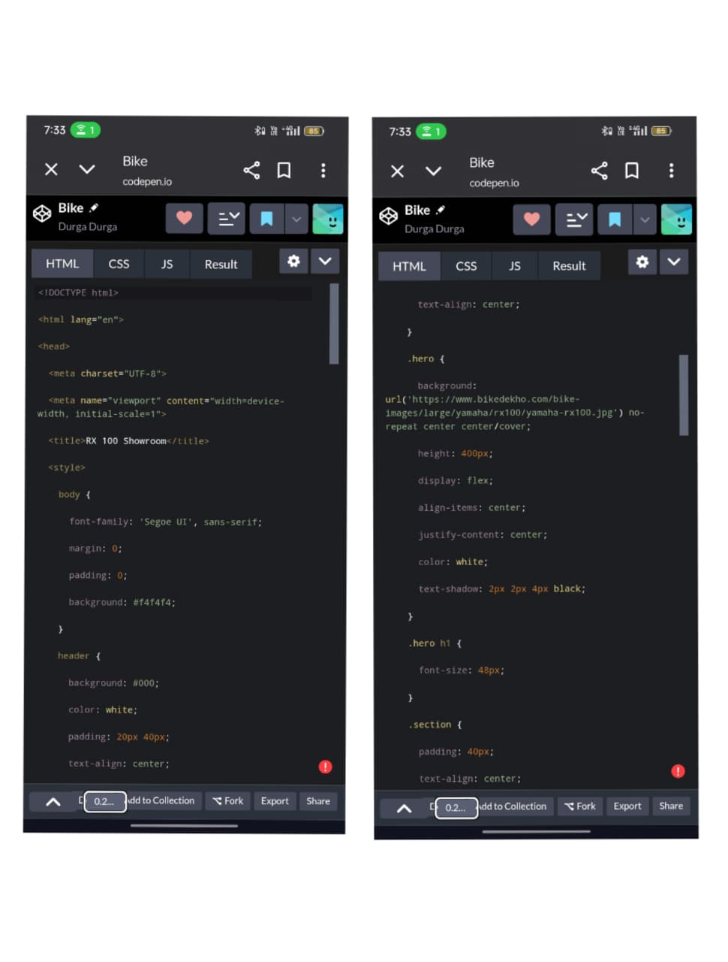

CODING AND SCREENSHOTS
3/21/2024 Annual Review
10

Slide 11
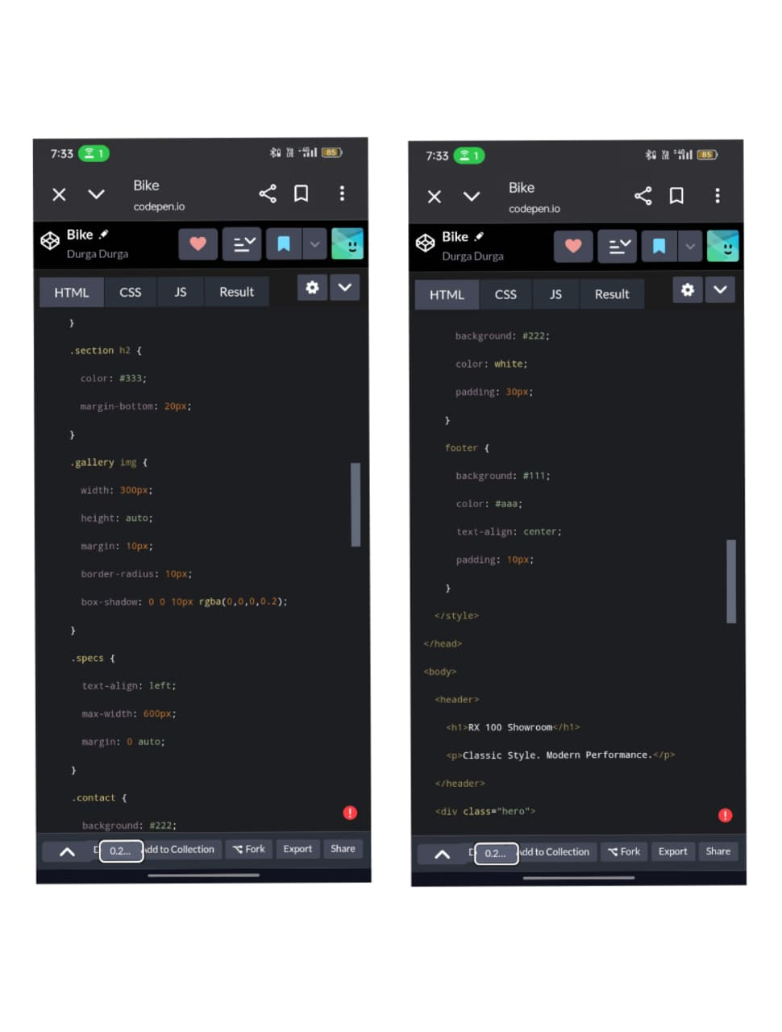

Slide 12
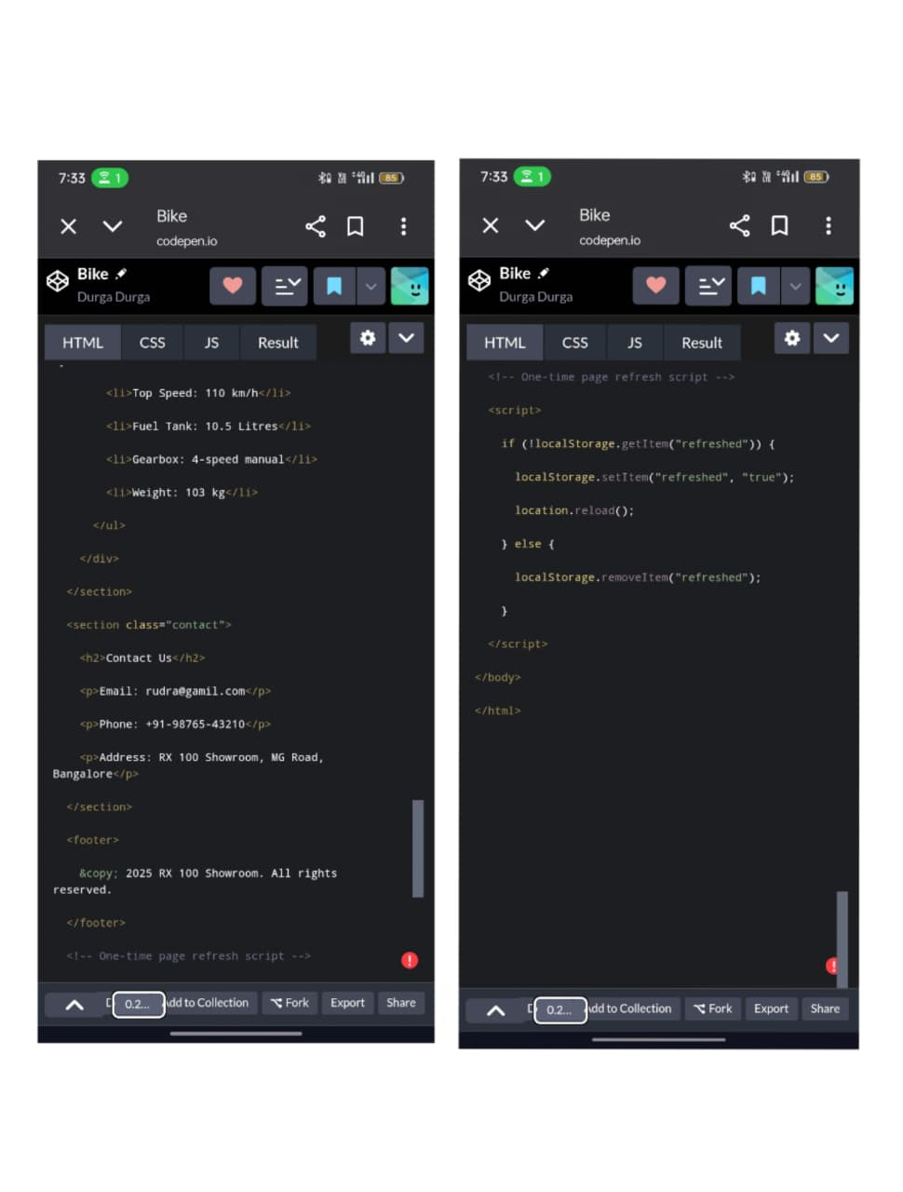

Slide 13
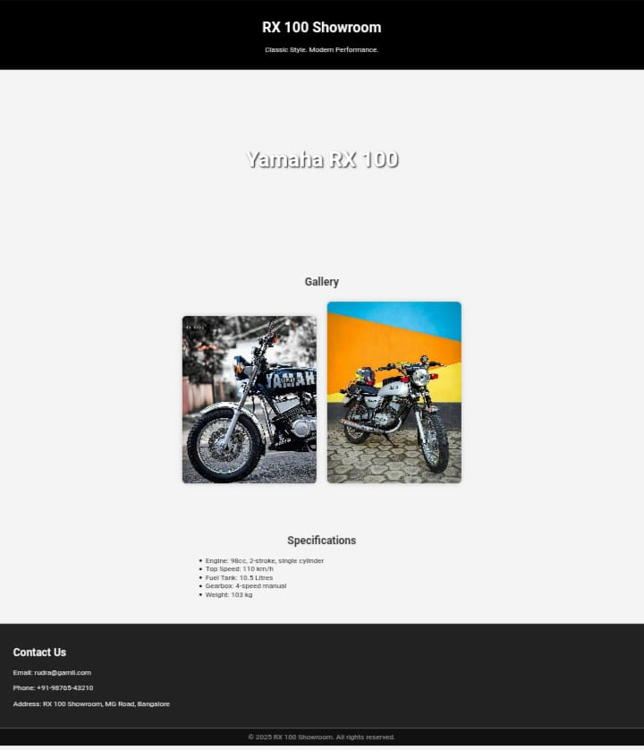
RESULT AND SCREENSHOT

Slide 14
CONCLUSION
RX100 digital advertisement successfully transforms a classic bike into a Modern digital icon.
Unlike posters , this interactive ad reaches wide audiences across devices.
RevivesRX100’s brand legacy while engaging the new tech-savvy generation.
Creates opportunities for dealers , showrooms, and Yamaha to boost promotions.
14

